Slide 1
Growing Philosophy in Your School
Ellie Carne & Jim Connolly

Slide 2
Similar contexts, different approaches
Ellie
Jim
Large secondary
Secular state school
Aiming to secure KS5 recruitment and results to keep staff
(almost) Whole cohort GCSE RS (290)
A-level Philosophy (18) & A-level Religious Studies (8)
Large secondary
Secular state school
10 year plan to build and embed Philosophy
PPE in year 9 (32)
GCSE RS option (32)
A-level Philosophy (20)

Slide 3
Ellie at SWCHS
Our confident quality first approach

Slide 4
KS5 Co-ordinator
6 years ago
Today
5 students in year 13
8 students applying for Philosophy A-level
Poor ALPS score (progress scores) of 7 or 8
Low staff confidence: Elitism
School requested closure of the subject
…I get employed!
In 2022: 15 students in year 13 (4 going onto a degree in Philosophy or joint with Philosophy, all at Russell group universities)
2023 has 18 entries
40 students applying for Philosophy A-level 🡪likely class of 30
ALPS score of 2 (level with or above other humanities subjects)

Slide 5
How we got here
High quality teaching sells itself.
Logical thinking, evaluation and learning skills teaching explicitly from KS3 up
Maths requirement (grade 5+) for A-level
Teaching staff
Positivity and enthusiasm for the subject
Re-writing schemes of learning
More texts, reading philosophy for nuance and interpretation
Scaffolded practice of exam questions
Links with sixth form pastoral staff

Slide 6
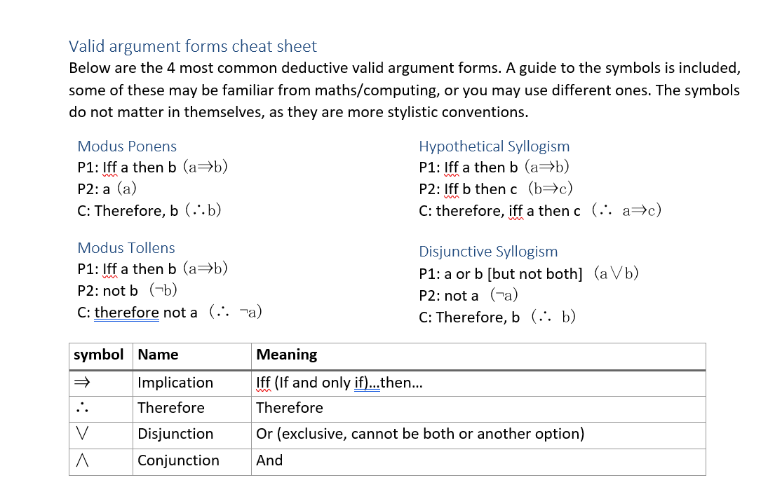
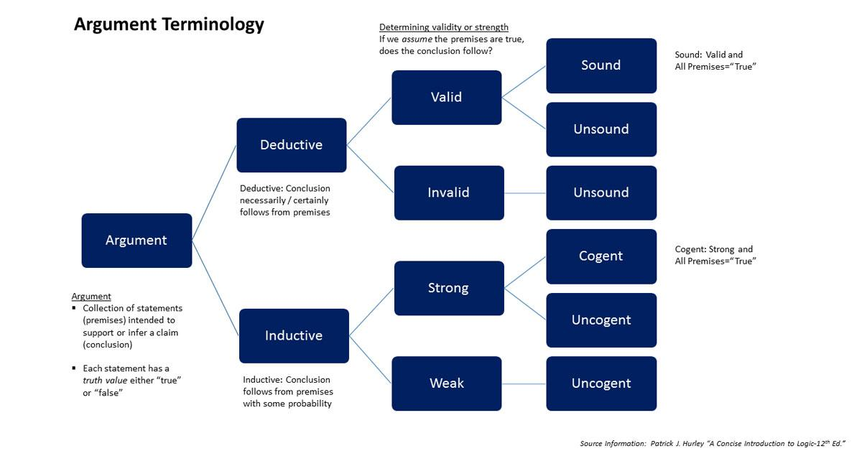
Logic Lessons KS5
Explicitly pre-teaching lots of the key logic and key terms encountered in the first half term.
Developing confidence so it is not all new when reading philosophers.
Teaching study skills through this such as summarising, reading for sense, revision.
Notes:
Using a variety of teacher made and copied resources to pre-teach key terms at the beginning of the AQA philosophy syllabus before they might appear elsewhere in the course. This means that they can feel more confident in their reading and writing and feel like “real” philosophers. Absolute focus on the precision of arguments.
Allows a depth to the subject which feels more authentic. Students can genuinely engage with current topics in philosophy.

Slide 7
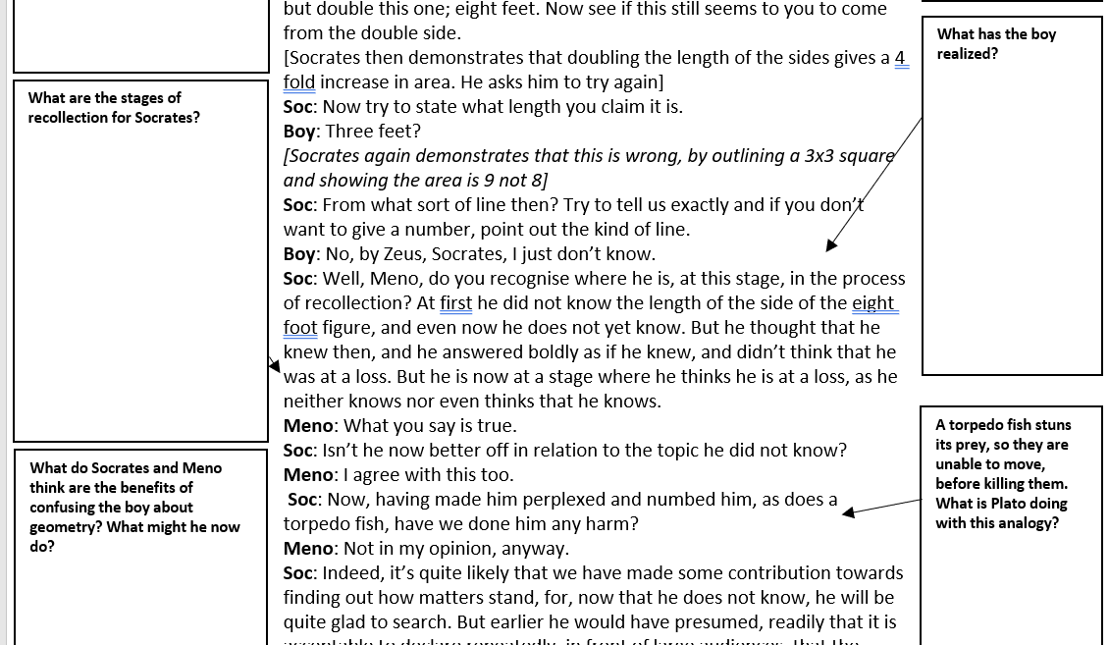
KS5 approach
Textual, analytical approach
See example guided reading homework sheets
Image analysis especially for Religious Philosophy
Modelling of how to read and write philosophy
High levels of feedback
WCF
Feedback sheets
Visualiser
Intervention “Seminars”
Test to re-teach

Slide 8
Teaching Staff
I am the only teacher of this subject with any degree content in Philosophy. (MA(Hons) Philosophy and Theology)
Historically many are “scared” of the subject
Cannot appoint high quality teachers with a background in Philosophy
Re-doing schemes of learning.
Adding teaching notes to explain core ideas
Supporting teachers with additional 1:1 support
CPD and high quality resources
Lacewing textbooks & Webinars
Going beyond the basics
Notes:
Staffing difficulties!
Refusals to teach the subject, leadership avoiding the subject or feeling it is lacking in value.
But developing confidence in this teaching of analytic philosophy is important.

Slide 9
Philosophical thinking across units
Examples at KS3
“How do Dharmic conceptions of the divine influence understandings of personhood and ethics?” (personhood, Animal ethics, qualities of God)
“Can art help a Buddhist understand the nature of enlightenment?” (Aesthetics, change and causation)
“Why are there moral disagreements?” (Moral theory, Meta-ethics)
“Are there any conclusive arguments for or against God’s existence?” (Deductive and inductive arguments for God’s existence, critiques of religion)
Notes:
Ambitious curriculum. Units use philosophical stimulus materials and teach explicitly argumentative techniques including writing and reading philosophically. Building up skills through upskilling teachers as well.
Examples of resources used for KS3 are in the

Slide 10
GCSE…?
Less easy within the context
Not (currently) teaching the Philosophy units
Focus on evaluative skills and analysis and evaluation of nuance within texts.
Similar approaches to guided reading and clear lines of evaluation.
Evaluation sheets
Notes:
3 hours a fortnight to deliver the full GCSE across mixed ability classes with a grade range of 2-9.
Those not expected to reach a grade 1 (usually 6 ish per year) complete an ASDAN course which includes, surprisingly more Philosophical content.

Slide 11
Jim at WHS
Content at every opportunity

Slide 12
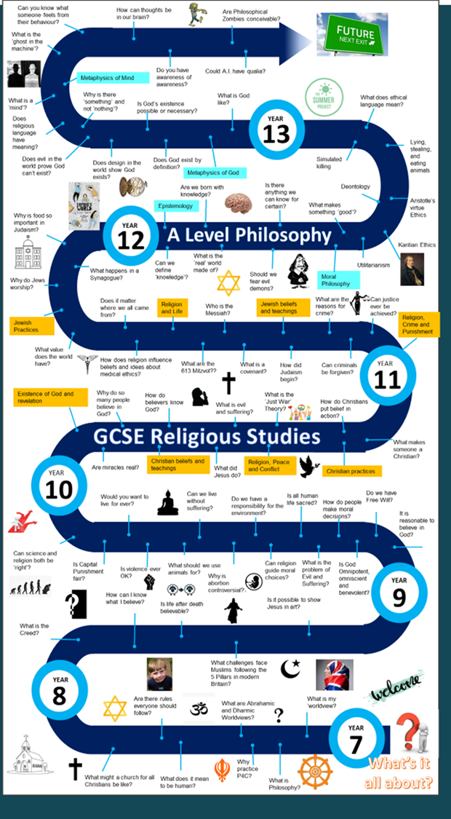
The long view
In 2014 we decided to make Philosophy an integral part of the Religious Studies curriculum.
We had lost our RS A-Level due to lack of numbers and we were struggling to develop a GCSE full course as all students completed the half course GCSE.
We needed to reinvigorate a department and curriculum which excited neither students nor teachers.

Slide 13
Going ‘all in’
We decided that we were going to launch the Philosophy A Level.
The aim was to have an intake equal or higher than all other humanities subjects.
To achieve this we knew we needed to build pathways from Year 7 through to the 6th form.
We needed to do so in a way that built a culture that made Philosophy ‘normal’ in the school.

Slide 14
Aligning with school priorities
When the school revisited the homework policy we made our philosophy questions a model that could be shared with staff.
When the school asked departments for Year 5 and 6 taster lessons we made sure that it was a philosophy lesson.
When the school wanted a focus on extended writing we put our model for developing A Level essay writing in the spotlight.
When the school made oracy a school priority we shared material from P4C with staff that used examples of philosophical questions.
When the school developed a ‘Creative Curriculum’ offer for Year 9 students we argued hard for PPE to be on the options.
When the 6th form wanted to add enrichment to each department we launched an independent summer research project for Year 12s which is presented in a TEDx format.

Slide 15
Which are the Year 12 projects and which questions come from Year 9?
Funeral archaeology: Graverobbing or science?
What are memories?
Are humans naturally evil?
Why is football the ‘beautiful’ game?
Is addiction good or bad?
Are dolphins conscious?
Is the ethics of care a preferable approach to androcentric traditional moral theory?
How could philosophical thinking change the world?
Are you an N.P.C.?
What is freedom?
Morality: is it made up?
How should we train young people for the future?
Does rationalism or empiricism give the correct account of how we get knowledge?

Slide 16
The final steps
We now have a clear pathway within school established.
We are developing links with other schools through our annual A Level Philosophy and RS conference at Carlisle Cathedral.
We have had ex A-Level students return to run sessions with current students on University life and share their Year 12 research projects with the ‘next generation’.
The hope is that from 2024 we will mark the 10th anniversary of Philosophy at WHS with the creation of a formal Old Scholar’s network.

Slide 17
The single best thing we have done
What colour might a zebra
be without it’s stripes?
Do all Mars Bars taste the same?
Was Thanos right?
Is it ever right to bully a bully?
Are questions or answers more important?
Key Stage 3 homework
One question each week developed from Ian Gilbert’s ‘Thunks’
To be discussed with parents and recorded in their journal
Every student prepares to feedback their response at the start of every lesson.
It transformed the relationship we had with students, engaged parents and gave our department a personality within the school.

Slide 18
Key take aways
Do what works for your context
Be ambitious!
Constant progress is better than everything all at once and burning out.

Slide 19
Questions and Discussion

